Slide 1
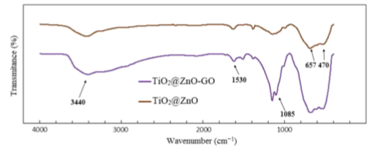
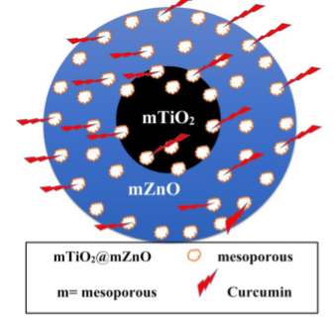
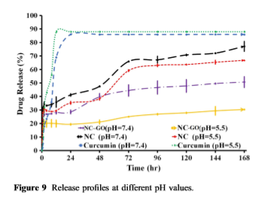
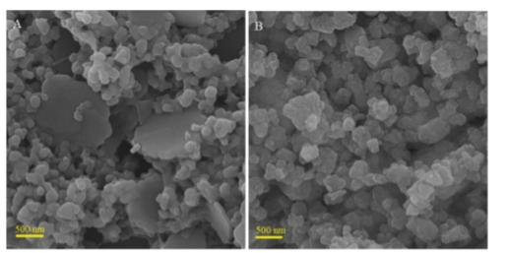
Mesoporous titanium dioxide@zinc oxide-Graphene oxide nanocarriers for colon-specific drug delivery DOI:10.1007/s10853-017-1673-6
Héctor Andrés Martínez Máynez
A01240511
This study presents a novel method for the production of core-Shell ceramic nanoparticles doped with Graphene oxide for the design of drug delivery by generating the TiO₂ core by the sol-gel method and the zinc oxide mesoporous Shell by sonochemical method. The core-Shell particles was doped using Graphene oxide sheets. The drug delivery system was tested using curcumin with a pH sensitive delivery system.
Infrared analysis of Core shell nanoparticles showed a significant difference when it is doped with Graphene oxide. On pristine TiO₂-ZnO particles only show bands on 470 and 657 cm⁻¹ corresponding to the Ti-O and Zn-O bonds. When doped with graphene oxide new bands can be observed on 1085 cm⁻¹ for stretching vibration of C-O and 1530 cm⁻¹ for C-H bonds, also a broad band appeared on 3440 cm⁻¹ that confirms the presence of –OH groups on the nanostructure
Release profiles of curcumin shows that the Graphene doped nanoparticles are better at drug-delivering when the pH is neutral reaching up to a 88% of release on the first 12 hours.
Basic diagram of Core-Shell TiO₂-ZnO-Graphene-Curcumin nanoparticle
SEM images of Zinc Oxide-TiO₂ core Shell particles (left) and ZInc Oxide-TiO₂-Graphene particles

